Slide 1









Maintaining SmartX Operations for OF@TEIN+ Distributed Cloud-native Edge Boxes
IoTcloudServe@TEIN 3rd Collaboration Community Meeting
8 September 2020, Thailand-Laos-Korea
Muhammad Ahmad Rathore
ahmad@smartx.kr
Networked Intelligence Lab
School of Electrical Engineering and Computer Science (EECS)
Gwangju Institute of Science and Technology (GIST)
Gwangju, South Korea

Slide 2
Research Work
[Conference][Published] “Persistent Operation of OF@TEIN+ Playground Verified by SmartX Multi-View Leveraged Visualization”, Proceedings of 2020 the 10th International Workshop on Computer Science and Engineering (WCSE 2020) Yangon (Rangoon), Myanmar (Burma), February 26- February 28, 2020, pp. 73-78
Journal][Accepted] “Maintaining SmartX Multi-View Visibility for OF@TEIN+ Distributed Cloud-native Edge Boxes”, Transactions on Emerging Telecommunications Technologies (ETT), WILEY, (2020)
3rd Collaboration Community Meeting, 8 Sep 2020, Thailand-Laos-Korea

Slide 3
Outline
OF@TEIN+ Playground: Overview
Cloud-native Computing
Production-focused Playground Tower
Maintaining Operations of OF@TEIN+ Playground
Step 0: Requirements and Issues
Step 1: Maintaining persistence SmartX Multi-View Visibility
Step 2: Design for Maintaining Persistent Playground Visibility
Step 3: Maintaining Persistent Playground Operations (Visibility) for Service Developers and Operators
Step 4: Results and Verification
[4-1] Pre-processing Visibility Data
[4-2] Maintaining SmartX Multi-View Visibility : Results of Implementation Use Cases
[4-3] Spatio-temporal Summarized Visualization
[4-4] Verifying SmartX Containerized IoT-Cloud service with IoT Devices
3rd Collaboration Community Meeting, 8 Sep 2020, Thailand-Laos-Korea
Notes:
This is the outline of my today’s presentation…

Slide 4

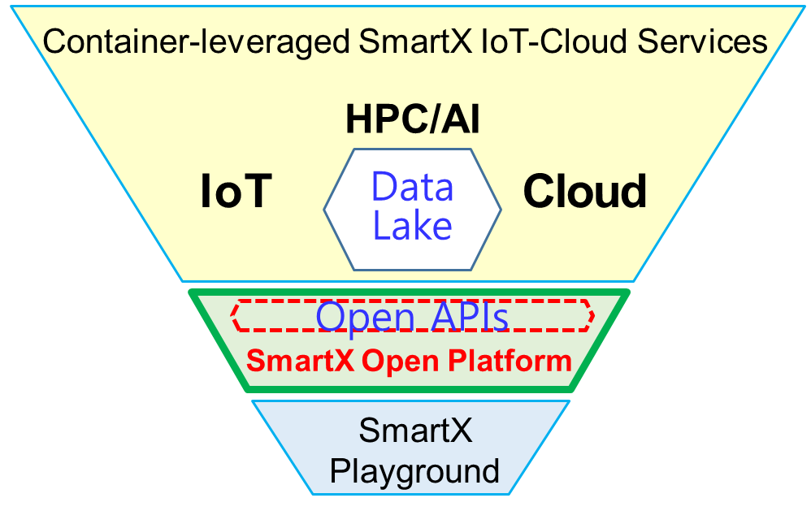
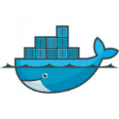


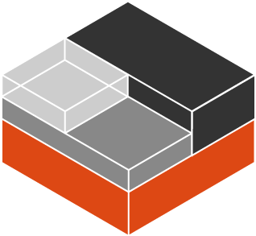


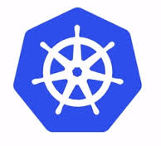





Cloud-native Computing
Cloud native computing uses an open source software stack to be:
Containerized
Dynamically orchestrated
Microservices oriented
microservices + automation + DevOps
➔➔
Agility of software teams +
Resilience of applications.
SmartX
Open Playgrounds
3rd Collaboration Community Meeting, 8 Sep 2020, Thailand-Laos-Korea
Notes:
Unikernel: a specialised, single address space machine image constructed by using library operating systems. A developer selects, from a modular stack, the minimal set of libraries which correspond to the OS constructs required for their application to run. These libraries are then compiled with the application and configuration code to build sealed, fixed-purpose images (unikernels) which run directly on a hypervisor or hardware without an intervening OS such as Linux or Windows.

Slide 5
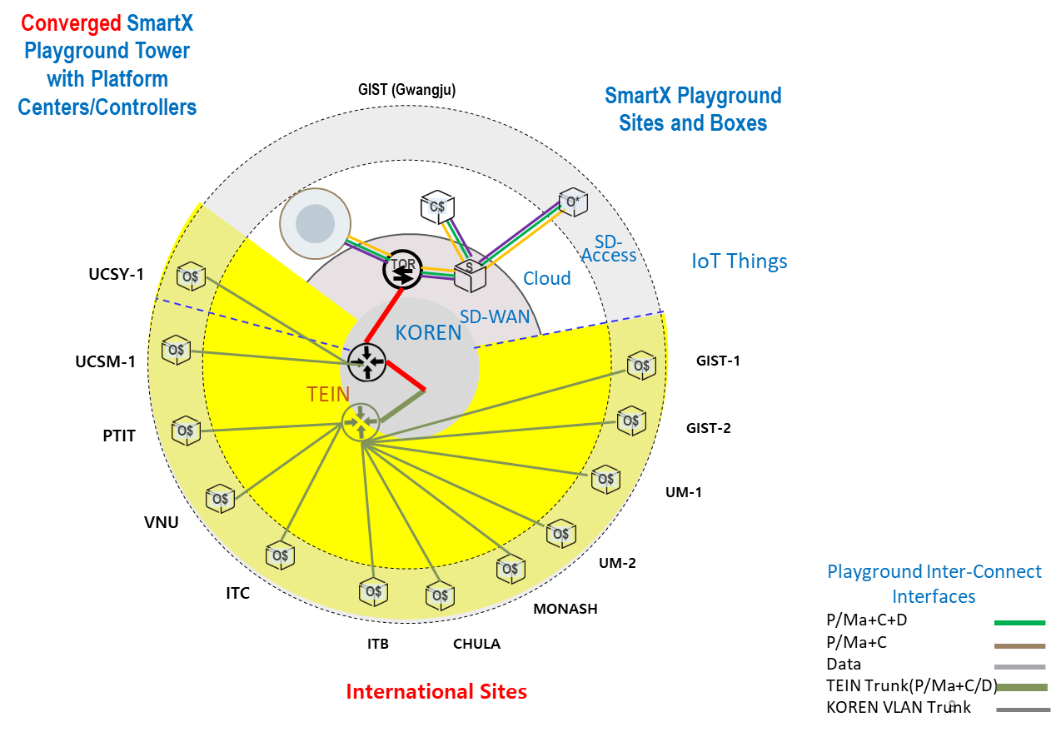
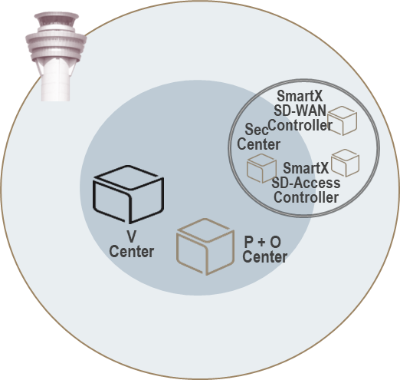


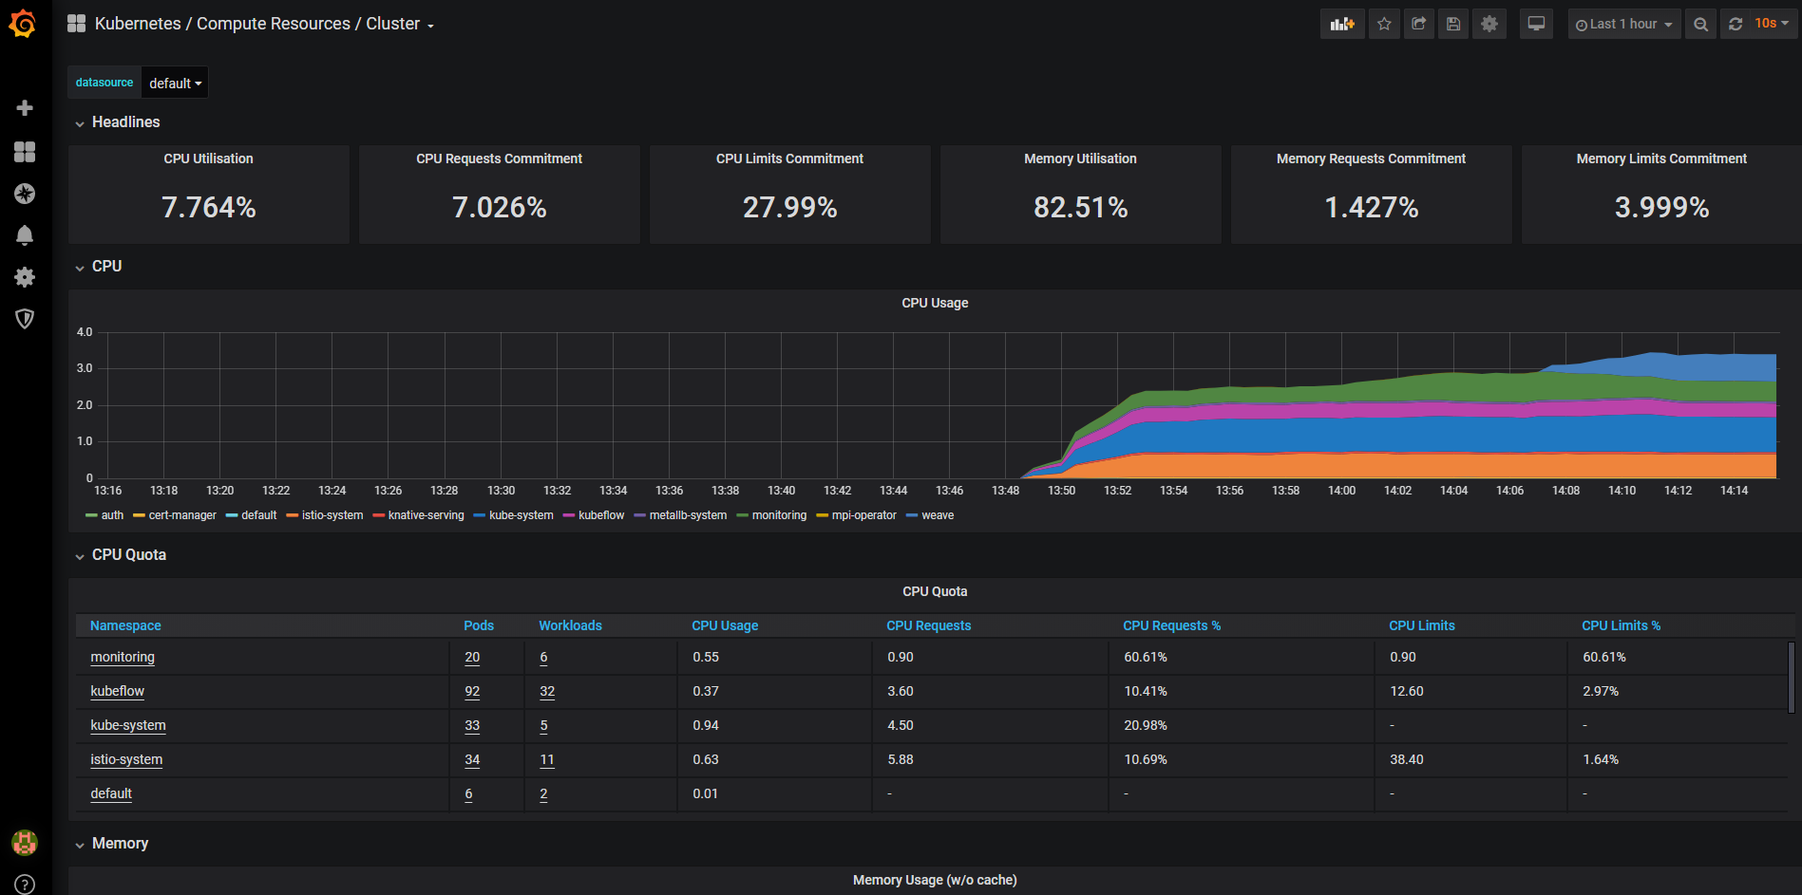



OF@TEIN+ Playground (2019) (Production-focused Playground Tower for SmartX Micro-Boxes Operation)
P+O
V
Centers
Multi-View
Playground Tower
DataLake
Kubernetes Master
Kubernetes Node
micro-box-gist-1
Kubernetes Node
micro-box-chula-1
Container
Container
Container
Container
Container
Container
SmartX Micro-Box
Kubernetes Node
micro-box-um-1
SmartX Micro-Box
10.110.157.73
10.100.80.205
10.100.80.206
Cloud
Multi-node Service
(measurement)
Container
Resource
Measurement
Container
Container
14 SmartX Micro-Boxes
Enable distributed cloud-native
(Kubernetes-orchestrated) playground
Visibility-enabled (i.e., monitored) and
Jointly operated by federated playground towers
SmartX Micro-Box
Deployment
Edge Devices
10.104.11.83
3rd Collaboration Community Meeting, 8 Sep 2020, Thailand-Laos-Korea
Notes:
This is base software progress.
With the Service architecture Kubernetes handles things that you often might have to worry about
Service discovery
Load balancing
Scaling
Service discovery allows each pod just needs to call the name of the service it wants to talk to
Services have multiple options
Session based load balancing
Single port based services
External Services
The Service architecture of Kubernetes can be scaled up to handle as many services as you would like for your system

Slide 6
Cloud-native Edge Playground: Requirements and Issues
Requirement 1
Edge computing leverages cloud-native applications to process/analyze some of their computing/storage close to the location where the data is generated by a large number of heterogeneous devices
Requirement 2
Edge Computing leveraged the benefits of cloud-native by keeping what is great about the cloud-native model (Microservices architectures, Containerized applications, and dynamically orchestrated), Yet applying it in the harsh physical and environment of IoT devices.
Requirement 3
Physical clusters in an edge-cloud infrastructure should be reconfigurable, which can properly configure baremetal and virtualized (p+v) resources on demand for developers to easily acquire their dedicated cloud-native testbeds
Issues
In a distributed environment, these resources/applications have varying running conditions depending on resource availability, quality of network connection, and being geo-distributed.
Identifying efficient methods for monitoring operational environment with continuity in order to maintain and sustain services
3rd Collaboration Community Meeting, 8 Sep 2020, Thailand-Laos-Korea
Notes:
To realize cloud-native multi-site playground, I consider these three requirements.
1- In a cloud-native environment, edge computing moves applications workload from a centralized location to remote locations, Thus improve latency as well as reduce the bandwidth constraints over the network and storage capacity at the center.
2- Edge Computing leveraged the benefits of cloud-native
3- Playground users (i.e. developers) may want to freely customize a cloud-native cluster for realizing their cloud-native services
Playground with Cloud-native edge boxes performance of resources/applications varies considerably depending on variations in running conditions e.g availability of virtual resources, network connection quality between distributed Boxes etc. Therefore tracking changes of operational environment is vital in order to maintain and sustain playground services. Therefore, the use of monitoring capabilities at each layer of cloud-native edge helps the playground operators/administrators to recognize where any resource(physical/virtual/network) bottlenecks.

Slide 7






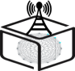

Maintaining persistence SmartX Multi-View Visibility
Workload-layer
(Monitor containerized applications )
T
Setup Cloud-native Edge Boxes
OF@TEIN+ playground with cloud-native edge supported Micro-Boxes
Resilient measurement
Visibility Data and Applications are recoverable under failure.
Efficient and timely measurement
Low network Bandwidth and
Low storage consumption
Verification:
Multiple Visualization schemes
Containerized
Functions
Pod
Pod
Application
Developer
App
App
App
App
App
Flow-layer
(Monitor overlay network traffic (near real-time), Packet tracing/sampling)
Application
Operator
Summarized
Identified
Collected
Packets
Playground Operator
Virtual Resource-layer
Virtual Networks
vSwitch
vLinks
vPorts
vSwitch
Physical Resource-layer
Resource-layer
Baremetal
Sites
Site
Operator
Underlay Resource-layer
Research Network(s)
Trans-Eurasia Information Network
Underlay Operator
Multi-layer visibility
(underlay, physical, and virtual resource-layers, flow-layer, and workload-layer) solution denoted as SmartX multi-view visibility framework (MVF)
3rd Collaboration Community Meeting, 8 Sep 2020, Thailand-Laos-Korea
Notes:
OF@TEIN+ playground maintains hyper-converged box-style resources named ‘SmartX Micro-Box’. These distributed boxes are configured to support interconnected cloud-native and edge computing with virtualized/containerized IoT-SDN-Cloud functionalities.
Although many conventional monitoring solutions are now available, maintaining multi-layer visibility (i.e. resource-layer and flow-layer) is still limited when operating such complicated infrastructures. To address this particular limitation, ‘SmartX Multi-View Visibility Framework’ (MVF) provides multi-layered visibility (underlay, physical, and virtual resource-layers and flowlayer)
Maintaining persistent visibility is one of the major operational challenges where SmartX MVF and related tools fall short. Especially due to the complexity of heterogeneous underlay networks with distributed resources, visibility is further restricted and this playground faces a variety of reliability-related issues such as network failures, limited resource availability, and flaws in software being triggered by environmental changes.
in the upgraded OF@TEIN+ playground, number of sites has much expanded in the existing setup. Due to the burden of large data volume generated and transferred by multiple distributed and physical/virtual devices, we experience overload on available network and storage capacity. The additional need for maintaining visibility, data aggregation for analysis, and time-series visualization deemed SmartX MVF infeasible at a certain point. Therefore requirements of applying multi-view visibility using SmartX MVF need to be improved with the existing environment. In response to the mentioned challenges, a solution is therefore needed that can monitor changes of operational environment and maintain long-term multi-view visibility and visualization, offering a persistent solution with reliable transfer and efficient storage in the complex distributed infrastructure.
In In OF@TEIN+ ,Multi-layer (i.e. resource-layer and flow-layer) visbility is essential for the effective operation of such modern ICT infrastructures to easily highlight the above mentioned issues.
Workload-layer Visibility
Monitor containerized applications
Inter-connected functions (e.g. Web, App, DB) and their placements
Flow-layer Visibility
Monitor overlay network traffic (near real-time)
Packet tracing
Packet sampling
Resource-layer Visibility
Monitor Playground resources
physical, virtual, and container
Monitor Infrastructure services
OpenStack Services, vSwitch service, SDN/Cloud Controllers services
Monitor Inter-connects
Physical
Management, Control, & Data planes
Virtual
vLinks, vPorts, vNetworks

Slide 8
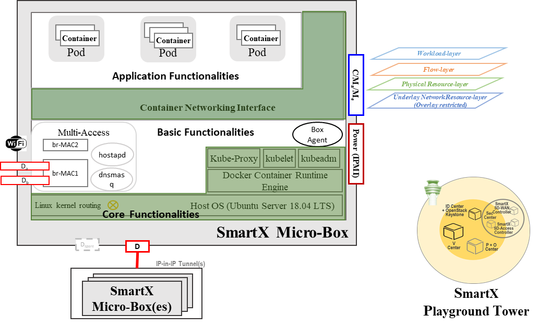
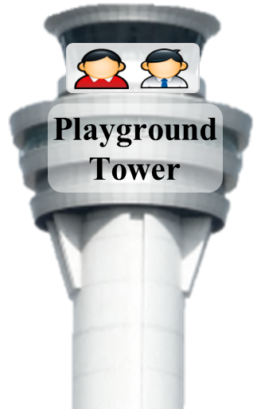
















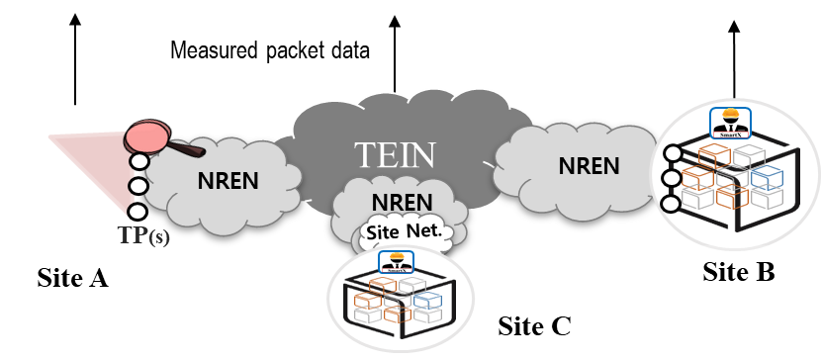
Design for Maintaining Persistent Playground Visibility
Flow-layer
Service Visualization
ZeroMQ
Persistent Producer
Resource-layer
Playground resources
ZooKeeper
Data Storage
Persistent Storage
Resource-layer
Monitor Inter-connects
Kafka
Broker 1
Data Parser/Metrics Collection/Aggregation
Summarization with Apache Spark
Agents
Kafka
Broker 2
Persistent Consumer
The SmartX measurement service (resource-layer) is managed by kubernetes as shown below.
Describe all functions in the kubernetes yaml template.
The functions of the service can be managed by kubernetes to maintain health status and operate stably
3rd Collaboration Community Meeting, 8 Sep 2020, Thailand-Laos-Korea

Slide 9
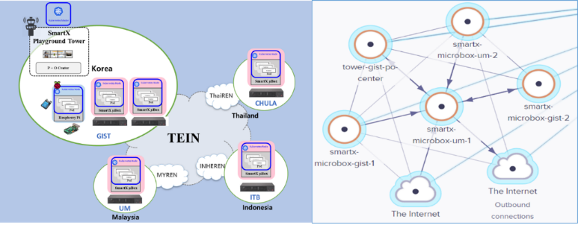
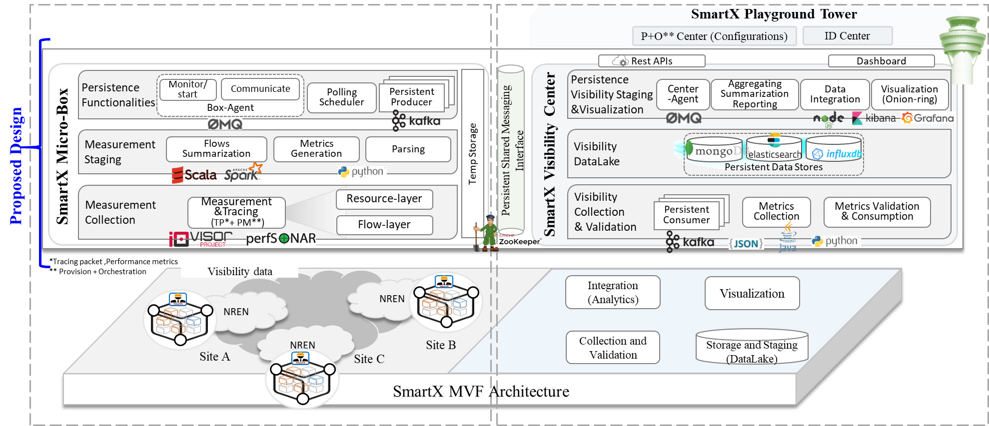
Design of Cloud-native Edge Boxes
Maintaining Persistent Playground Operations (Visibility) for Service Developers and Operators
Kubernetes cluster formed with Edge IoT-gateways distributed at Multi-site
3
2
4
4
1
2
Setup Cloud-native Edge Boxes Resilient measurement Multi Agent & Shared Messaging Interface | Efficient and timely measurement Flows Summarization Optimal polling scheme Verification: Visualization through Onion-ring visualization, Time-series based visualization, Historical summarized report
Design of SmartX Micro-Box
3rd Collaboration Community Meeting, 8 Sep 2020, Thailand-Laos-Korea
Notes:
In the given environment, we placed cloud-native edge boxes termed ‘SmartX Micro-Box’ aka Micro-Box, distributedat multi-site edge locations of OF@TEIN+ playground. These Micro-Boxes are commodity server-based hyper-converged resources (compute /storage/networking) to allow experiments (Cloud/Software-defined networking/Network Function Virtualization) over OF@TEIN+ playground.
(In OF@TEIN+ Playground, a multi-site affordable cloud-native version of the SmartX Playground is established that consists of software-defined (i.e., composable) Playground with hyper-converged Box-style resources named“SmartX Micro-Box”. These Boxes consist of interfaces for management/control and data, IoT devices, and remote power control. The SmartX Micro-Box is configured to support Cloud-native computing having a software stack that is microservices oriented with virtualized/containerized IoT-SDN-Cloud functionalities. In addition, capabili-ties of edge computing in these resources enable technologies that allow computation to be performed at the network edge near data source)
As shown in figure 4, measurement data consists of active and passive monitoring. Active monitoring periodically tracks the connection status among playground sites to offer enough insights to the playground operators. Secondly, passive measurement involved packet precise tracing of all incoming and outgoing packets from any particular site for analyzing passing traffic.
Measurements are transferred through a shared messaging interface ensuring reliable communication and resistance against losses. To ensure persistent execution of functionalities, Agents monitors and starts stopped services. Box-Agent asynchronously communicates with Center-Agent with status messages.
Three types of Visualization
Persistent storage, stores data for real-time and temporal analysis.

Slide 10
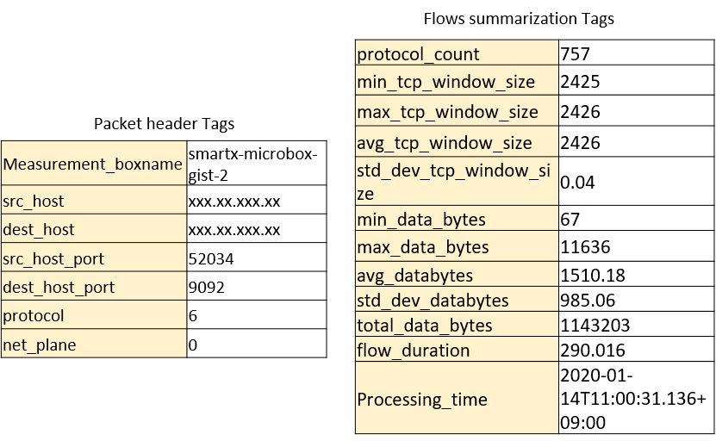
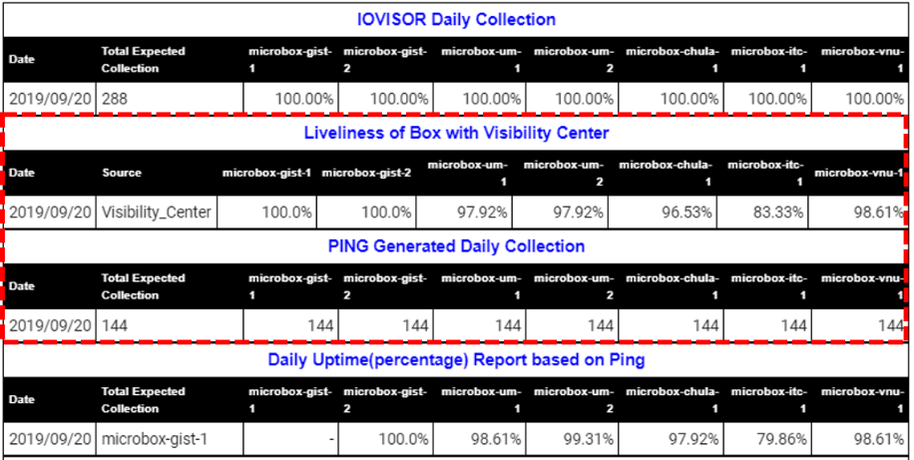
Pre-Processing For Maintaining Persistent Visibility
Raw Visibility Data for cpu/disk
[{"values":[0,0], "dstypes":["derive","derive"], "dsnames":["io_time","weighted_io_time"], "time":1589692165.948, "interval":10.000, "host":"smartx-microbox-gist-2", "plugin":"disk", "plugin_instance":"loop0", "type":"disk_io_time", "type_instance":""}] | [{"values":[63.9020263657957], "dstypes":["derive"], "dsnames":["value"], "time":1589692165.948, "interval":10.000, "host":"smartx-microbox-gist-2", "plugin":"cpu", "plugin_instance":"1", "type":"cpu", "type_instance":"idle"}] | [{"values":[0,0.30004865136956], "dstypes":["derive","derive"], "dsnames":["read","write"], "time":1589692165.948, "interval":10.000, "host":"smartx-microbox-gist-2", "plugin":"disk", "plugin_instance":"nvme0n1", "type":"disk_time", "type_instance":""}]
3rd Collaboration Community Meeting, 8 Sep 2020, Thailand-Laos-Korea
Notes:
Multi-view visibility data from Micro-Boxes gets collected in the DataLake of Visibility Center. For verification of persistent visibility monitoring tasks, we organize and summarize visibility data.
Visibility collection provides useful troubleshooting points for operators over the running resources hence facilitate in sustainable operation.
For visualization of summarised persistent visibility, a customised tool generates aggregated visibility data for oneday. This compiled data is formatted as an HTML report and disseminated to the playground operators.
we configure a visualization tool to retrieve that information and create graphs/bars to display persistent visibility

Slide 11
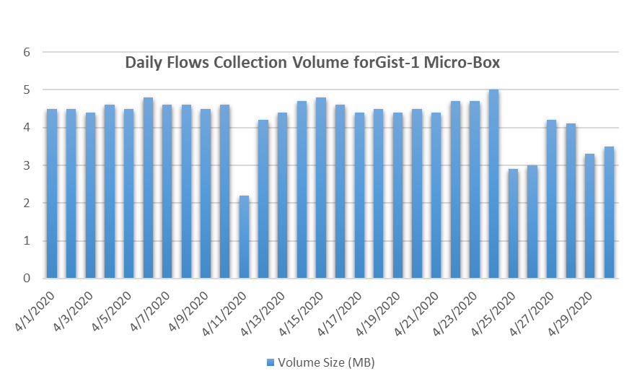
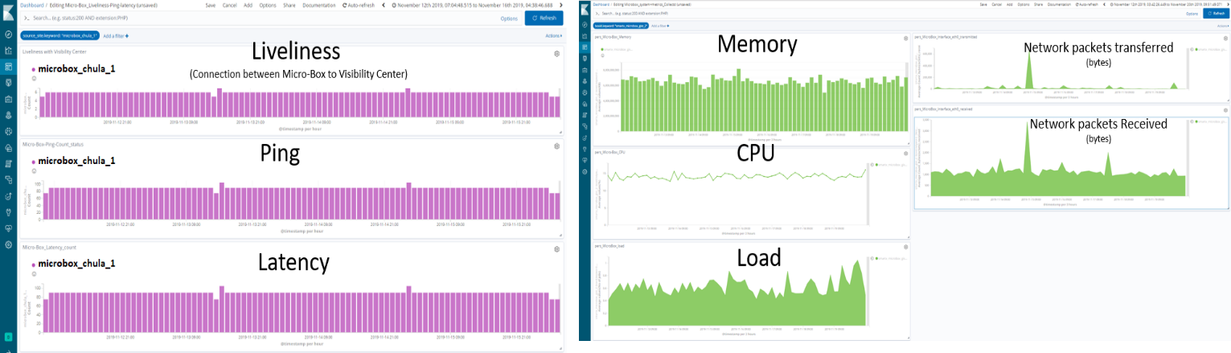
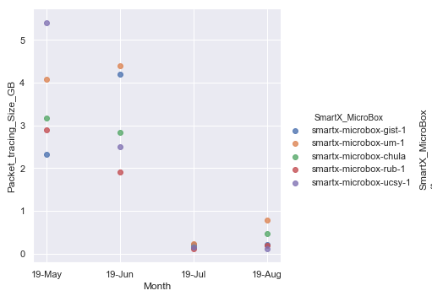
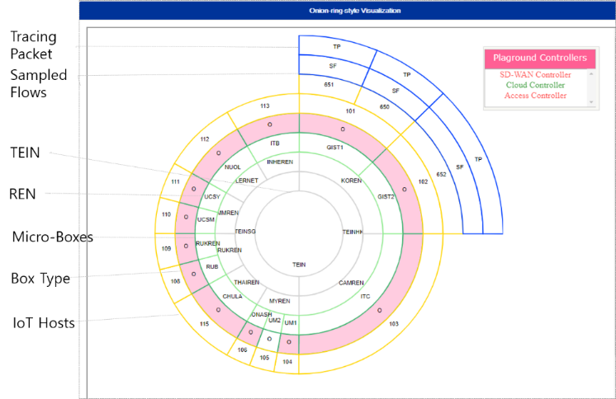
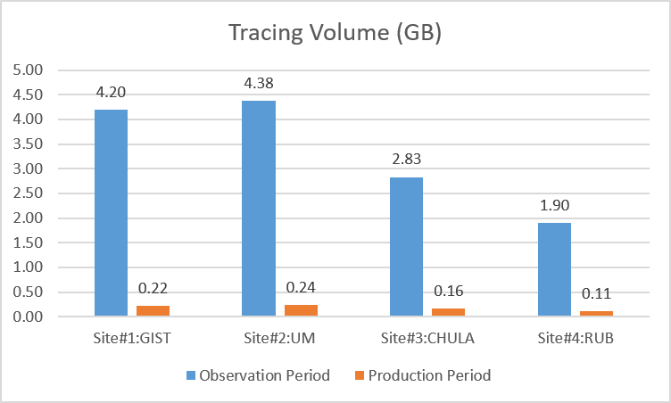
Maintaining SmartX Multi-View Visibility : Results of Implementation Use Cases
2. Visibility for resilient and efficient monitoring
1. Visibility for physical-resource visualization of testbed
Persistent Visibility
3. Visibility for Onion-ring visualization for OF@TEIN+ playground.
Visibility
Center
SmartX MultiView
Visibility Measurements
OF@TEIN+ Playground
3rd Collaboration Community Meeting, 8 Sep 2020, Thailand-Laos-Korea
Notes:
1- For visualizing collection of multiple measurements (liveliness, ping, latency etc.) at the Data-lake as time-series visibility data, we developed a dashboard.
2- Fig shows comparison of visibility collection during training and production period. After maintaining persistent visibility during the test period, in terms of collection rate and size improvement
3- To facilitate OF@TEIN+ playground developers and operators with visualization and to verify multi-view visibility from distributed Micro-Boxes, we leveraged onion-ring visualization as shown in Fig 20. Visualization dashboard enables the playground operators and developers to verify the overlay-based playground topology and to check association with the underlay WAN networks belonging to separate network operators. From the inner ring to the outer one, the underlay resource layer consists of international network PoPs (TEINSG and TEINHK), national PoPs (e.g., THAIREN, KOREN, ..) and sites (e.g., UM, CHULA,..). On top of sites, physical boxes are shows. Next ring shows the containerized resources with their IDs. The blue ring shows samples flows and traced packet of each containerized resource.

Slide 12
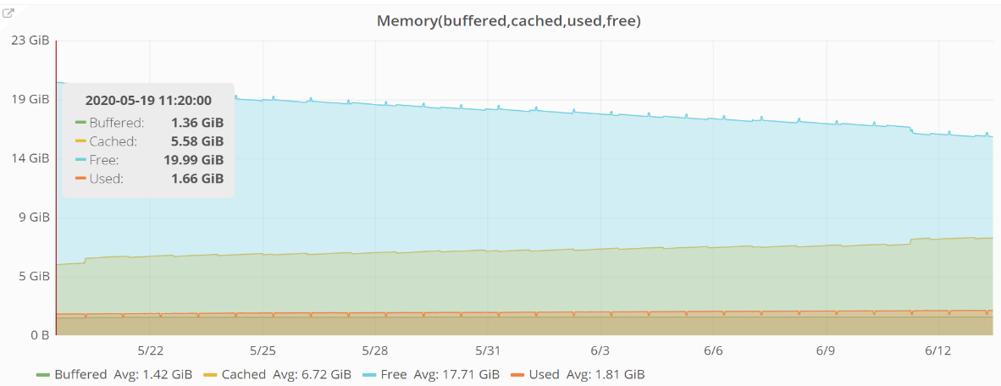
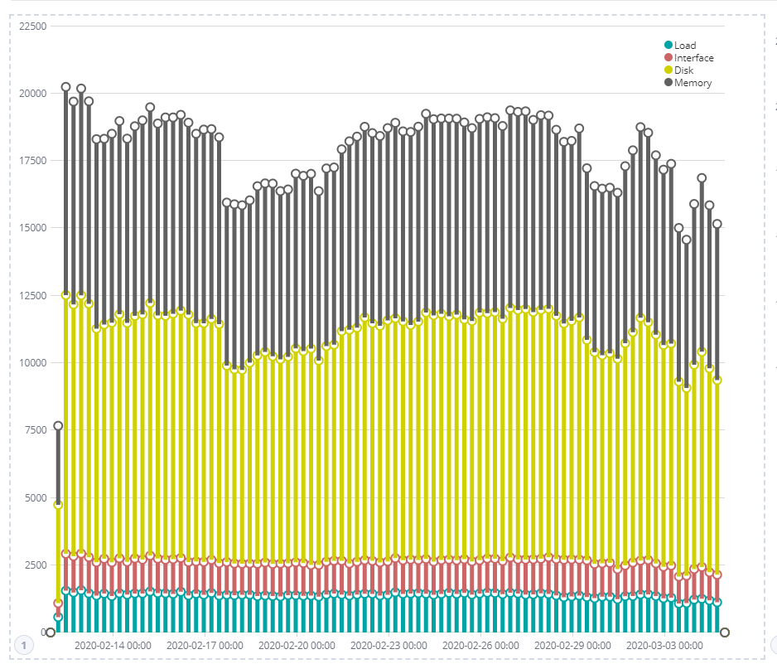
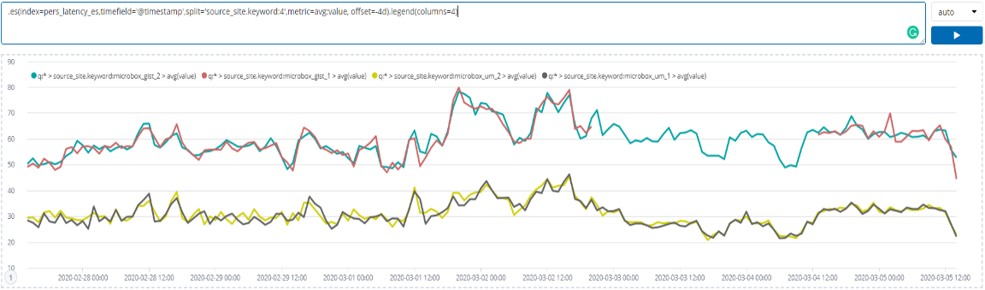
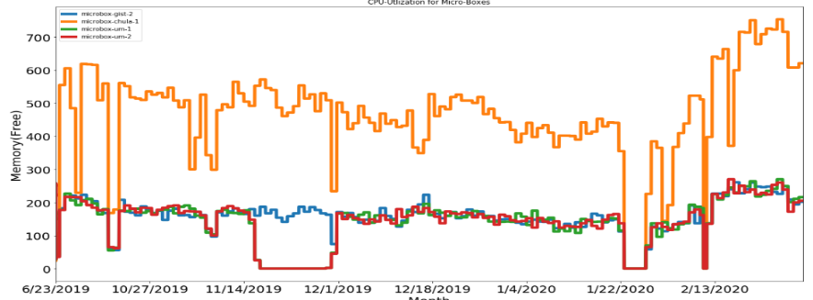
Spatio-temporal Summarized Visualization : Verification
1. Results of Visualization for single metrics of system Utilization metrics (Memory) for a single site
2. Results of visualization for multiple metrics of physical resource layers from a single site over time-line
3. Result for comparison of visibility measurements from multiple sites over time-line
4. Results of trends pattern based visualization of memory utilization for multiple sites over time line
3rd Collaboration Community Meeting, 8 Sep 2020, Thailand-Laos-Korea
Notes:
First measurement metrics that belongs to same category are summarised9over a particular time-period to show resource distribution among them.
Second we provide visualization of multiple metrics for single-site to identify mutuality between them. For example CPU utilization metrics are visualized on one page to identify similar patterns.
Third we provide summarized visualization from multiple sites which is useful to identify the comparison in heterogeneous networks for identifying how metrics in multiple sites change and differ from each other.

Slide 13
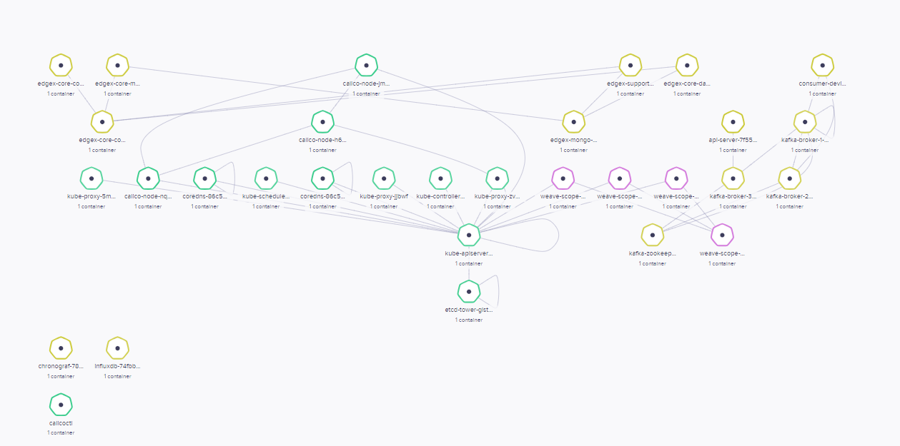


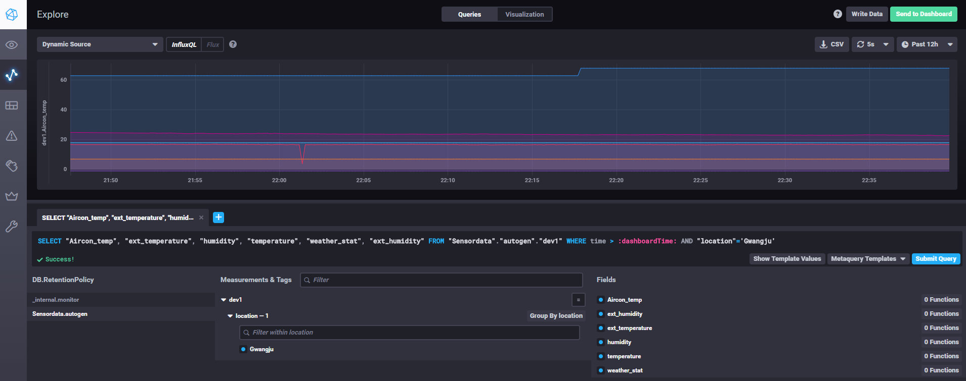
Verifying SmartX Containerized IoT-Cloud service with IoT Devices
DevOps Post
You can check the application service data visualization
at the chronograf connected with influxdb
Please Access https://DevOps Post_IP:32016
3rd Collaboration Community Meeting, 8 Sep 2020, Thailand-Laos-Korea
Notes:
This is base software progress.

Slide 14
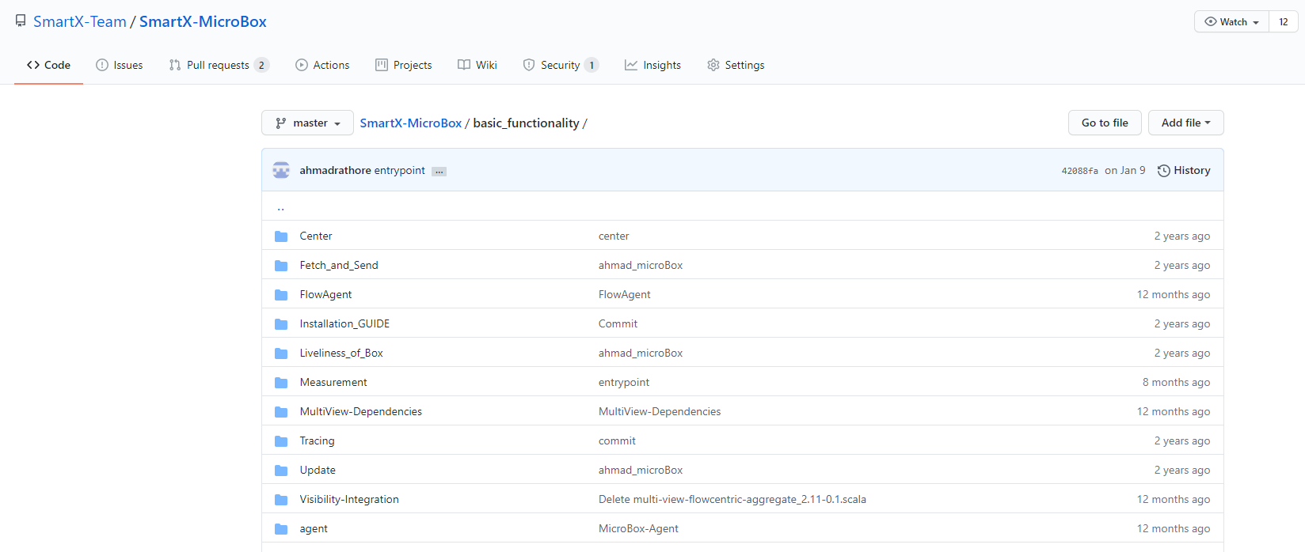
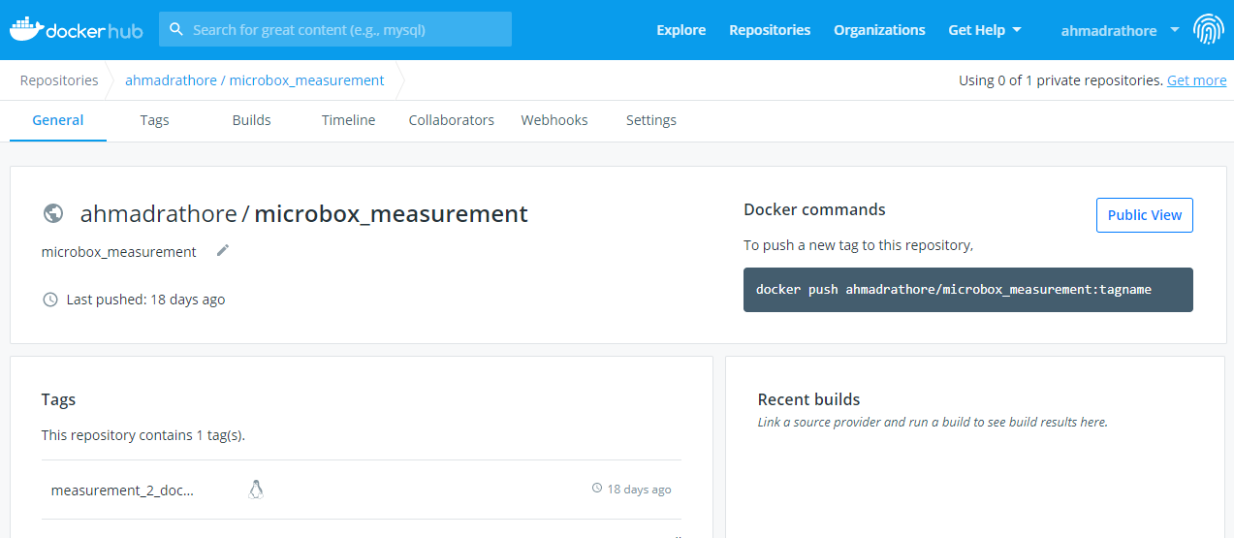
Project Resources
https://github.com/SmartX-Team/SmartX-MicroBox/
3rd Collaboration Community Meeting, 8 Sep 2020, Thailand-Laos-Korea

Slide 15
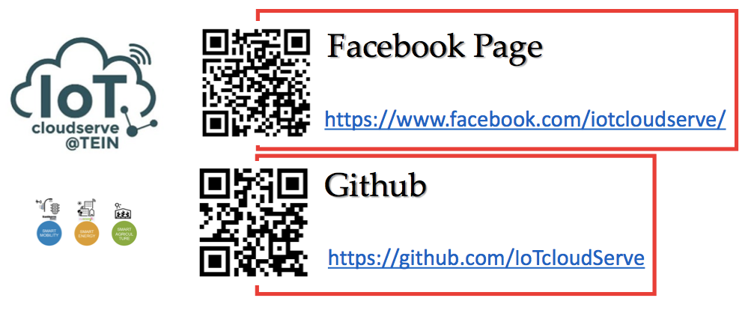
3rd Collaboration Community Meeting, 8 Sep 2020, Thailand-Laos-Korea

